Slide 1
PPO-Based Control of an Active Motion Surface for Parcel Singulation
Final policy selection and robustness assessment
Matteo G. Cigada 10767277
Marco Davi’ 10809038
Simone D’Inca’ 10837331
Prof. Loris Roveda - Machine Learning for Mechanical Systems - A.Y. 2025-2026

Slide 2
Contents
Environment, reward, and physical KPI
AMS model, downstream reward, and edge-based metric
PPO baseline
2000-episode reference configuration and KPIs
Bayesian-optimized PPO Policy
High-fidelity BO and best candidate selection
Robustness assessment
Multiseed validation and non-nominal stress campaign
Conclusions and Future improvements

Slide 3
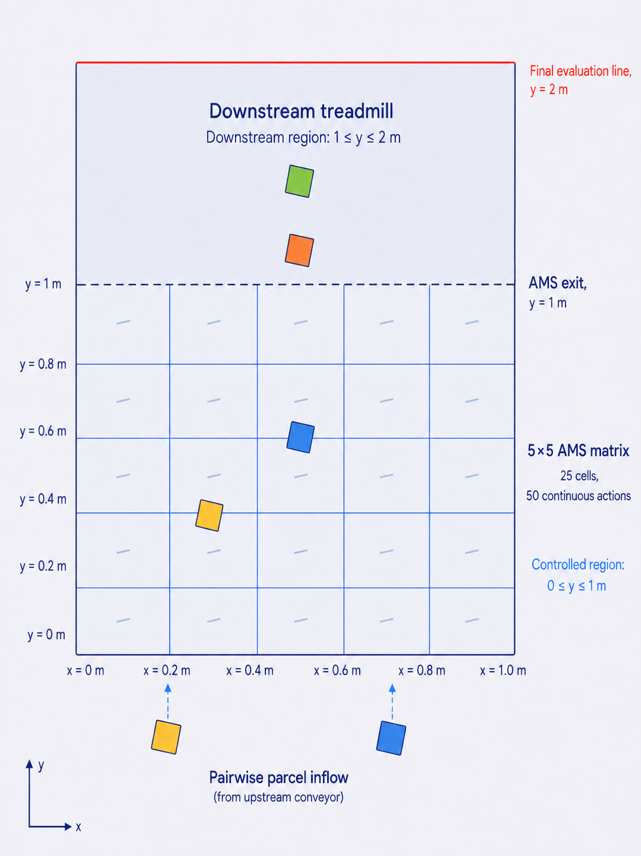
PPO acts on the AMS; singulation is evaluated downstream
Implemented system
• 5×5 AMS matrix with 0.2 m cell side
• 25 cells × 2 commands = 50 continuous actions components
• Commands: actuator rotation and velocity magnitude
Nominal parcel flow
• 10 parcels per episode, generated in pairs
• Pair generation period: 0.75 s
• Downstream treadmill speed: 1.9 m/s
Physical regions
• PPO-controlled AMS region: 0 ≤ y ≤ 1 m
• Passive downstream region: 1 ≤ y ≤ 2 m
• Final evaluation line: y = 2 m

Slide 4
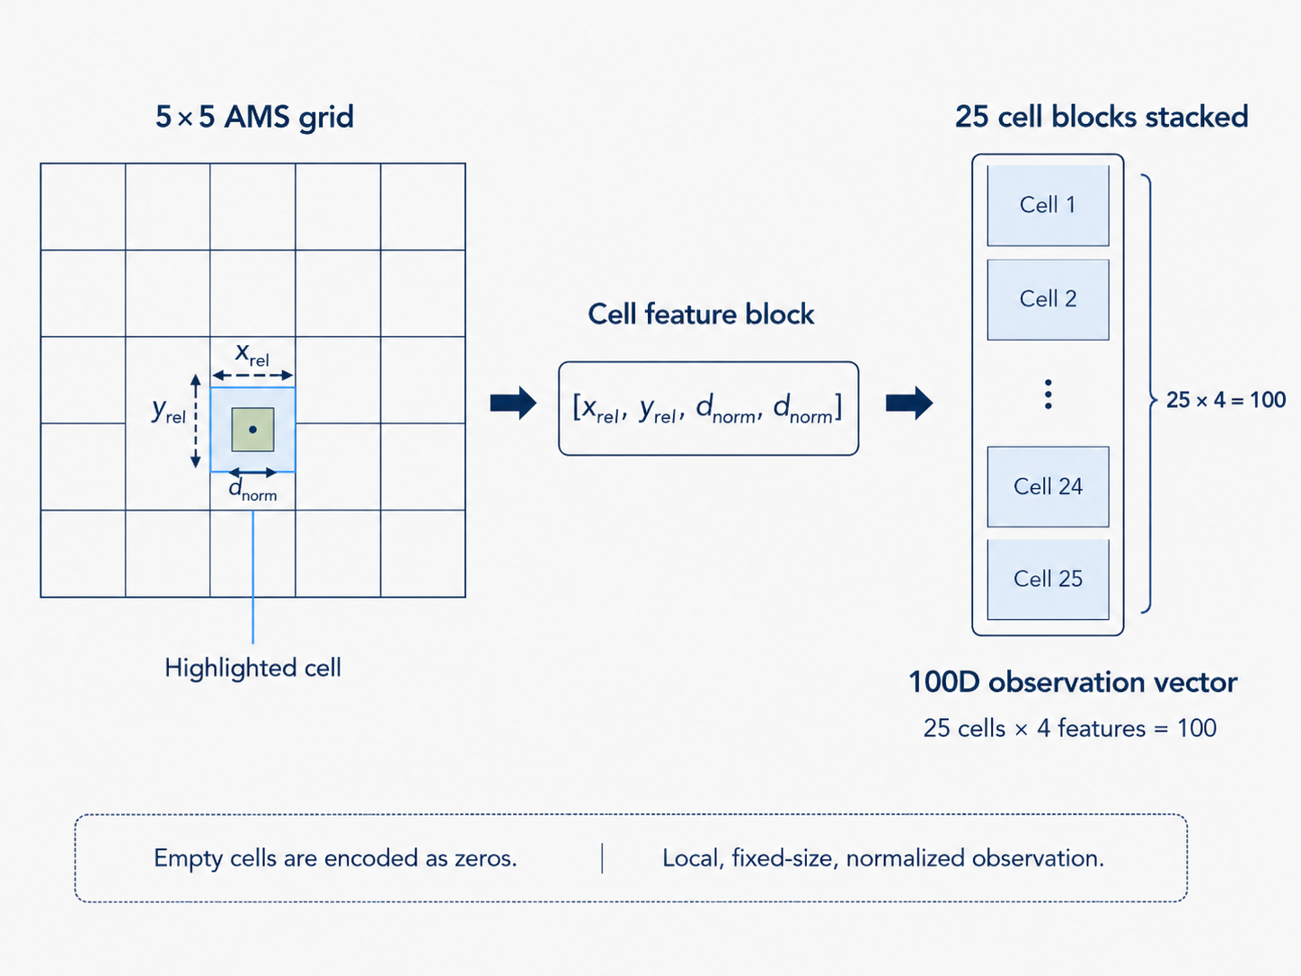
The PPO agent observes a normalized local representation of the AMS
Grid-based observation
• 5 × 5 AMS cells
• 4 features per cell
• Observation dimension: 100
Cell feature block
[x_{rel}, y_{rel}, d_{norm}, d_{norm}]
where:
• x_{rel}, y_{rel}: normalized parcel centroid position within the cell
• d_{norm}: normalized parcel size
• empty cells are encoded as zeros
Normalization
• Removes dependence on absolute cell coordinates
• Keeps inputs in comparable numerical ranges
• Helps PPO process all AMS cells consistently

Slide 5
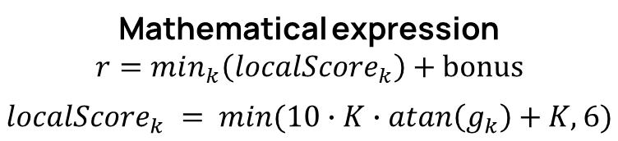
The training reward[*] promotes downstream pairwise separation
Rewarding logic
1 ≤ y ≤ 2 m
At each step:
1. Select parcels in the downstream region
2. Sort them by longitudinal position
3. Compute edge gaps between consecutive parcels
4. Convert each gap into a local score
5. Use the worst pair as instantaneous reward
Bonus:
+20 if all gaps are positive and at least three parcels are present.
Mathematical expression
$$r=min_{k}\left(localScore_{k}\right)+\text{bonus}$$
$$localScore_{k} = min(10∙K∙atan\left(g_{k}\right)+K, 6)$$
y = 2 m
y = 1 m
Parcel 1
Parcel 2
Parcel 3
gap g1
gap g2
localScore₁
localScore₂
y
K = number of downstream parcels, g_{k} = k-th edge gap
[*]: Roveda, Maccarini, Pura, Reiso & Spahiu (2025) Optimizing Parcels Sorting Through Reinforcement Learning for Intralogistics.

Slide 6
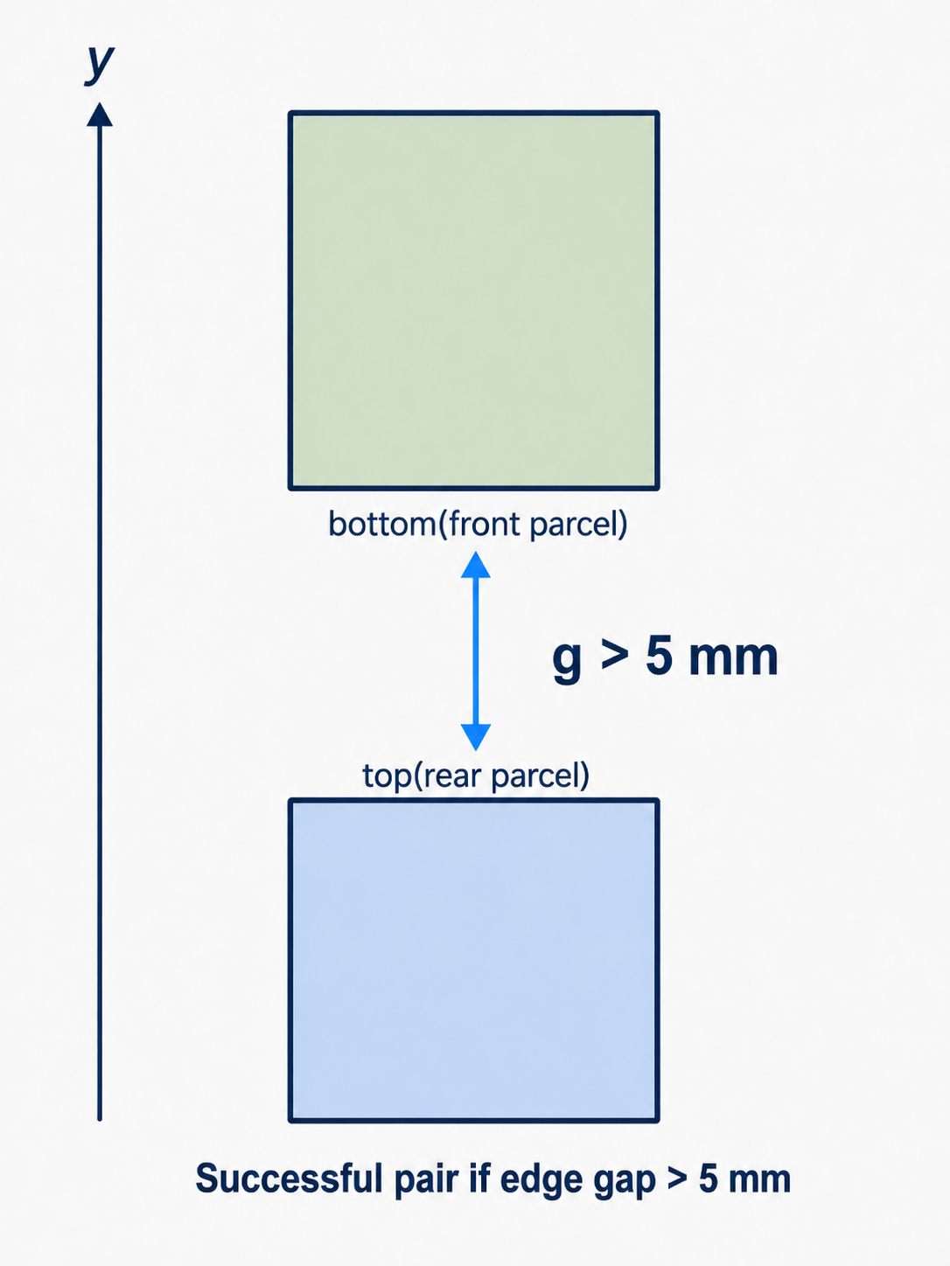
Final physical performance is evaluated using parcel-edge gaps
Evaluation line
• Final parcel configuration at y = 2 m
• After the downstream region
Edge-based pair gap
• g = bottom(front parcel) − top(rear parcel)
• Centroid distance is not used
Success criterion
• Successful pair: g > 5 mm
• Reported metric: percentage of successful consecutive pairs
The reward guides learning;
final edge gaps evaluate physical singulation.

Slide 7
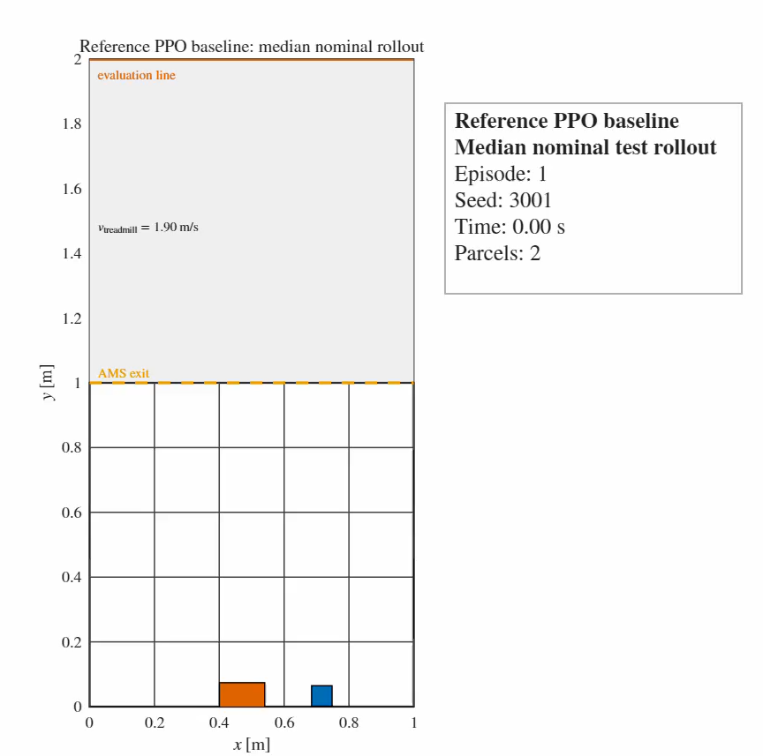
The 2000-episode PPO baseline was effective but still improvable
Reference PPO setup
Experience horizon: 500
Clip factor: 0.20
Actor/Critic LR: 1e-4
GAE factor: 0.95
Discount factor: 0.99
Entropy weight: 0.01
Training seed: 1
Reference PPO physical performance
Mean final accuracy>5mm: 93.44 %
Std. Deviation: 8.66 pp
Worst episode accuracy: 66.67 %
Mean Throughput: 8250.1 pph
Mean max overlap: 0.0500m
Mean Collision count: 20.53
Evaluation seed base: 3000
→
Margin to improve
→
Margin to improve
High average performance was achieved, but worst-case episodes and residual overlap motivated PPO tuning.
Example nominal test rollout for the reference PPO baseline

Slide 8

Bayesian Optimization candidates outperformed the reference baseline
PPO parameter Baseline BO_014
Experience horizon: 500 400
Clip factor: 0.20 0.098
Actor LR: 1e-4 5,66e-5
Critic LR: 1e-4 2,96e-4
GAE factor: 0.95 0.959
Discount factor: 0.99 0.995
Entropy weight: 0.01 1,60e-4
Epochs: 3 4
BO setup
• 2000 training episodes per configuration
• 100 nominal evaluation episodes
• Objective:
$$θ^{⋆}=\arg{\min_{θ∈Θ}\left[−{\overline{A}}_{\text{gt}\text{5}\text{mm}}\left(θ\right)\right]}$$
Ā_{gt5mm} = Mean Final Accuracy>5mm
Key interpretation
• BO candidates improve both accuracy and worst-case behavior.
• BO_014 gives the best accuracy, lowest std, and lowest overlap.
• BO_018 remains a strong throughput-efficient alternative.
Final choice
BO_014 prioritizes physical singulation quality over maximum throughput.
Parameter shift interpretation
• Smaller clip factor and lower actor LR suggest more conservative policy updates.
• Higher critic LR and one extra epoch improve value-function fitting during PPO updates.
• Much lower entropy weight reduces exploration once the policy has learned a stable singulation behavior.
• Slightly higher discount factor keeps downstream separation more relevant in the optimization.
Set | Mean overlap [m] | Throughput [pph] | Collisions
Baseline | 0,0500 | 8250,1 | 20,53
BO_008 | 0,0222 | 8052,1 | 5,05
BO_014 | 0,00133 | 7874,2 | 1,00
BO_018 | 0,00352 | 8244,7 | 0,25

Slide 9
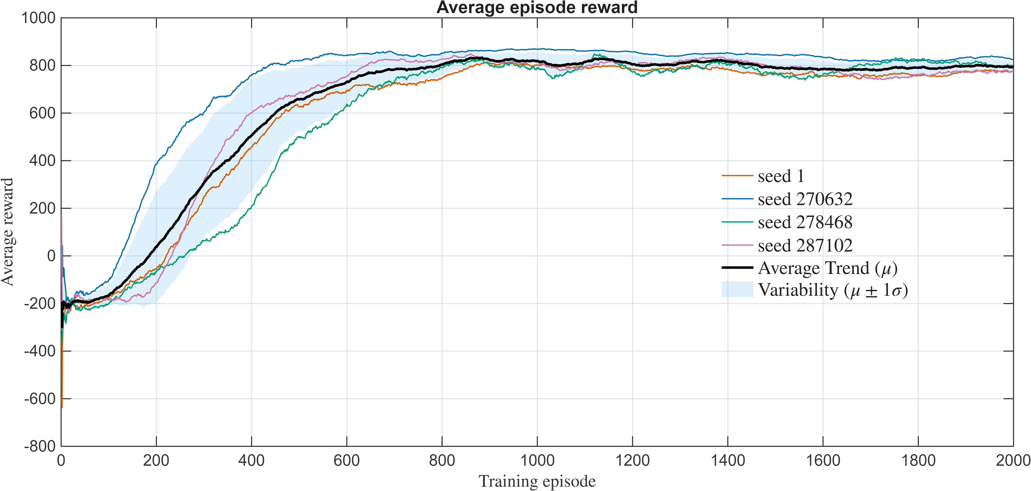
Multiseed validation confirmed the robustness of BO_014
BO_014 multiseed training average reward trend
Multiseed validation
• Final configuration: BO_014
• 4 independent PPO training seeds
• 100 nominal evaluation episodes per seed
Training diagnostic
• Reward trends indicate stable PPO training across seeds.
• AverageReward is not used as the final success metric.
Physical robustness
• Mean accuracy across seeds: 97.86%
• Std across training seeds: 2.22 pp
• Worst episode across all seeds: 77.78%
BO_014 is not dependent on a single PPO training realization and remains physically effective across different random seeds.

Slide 10




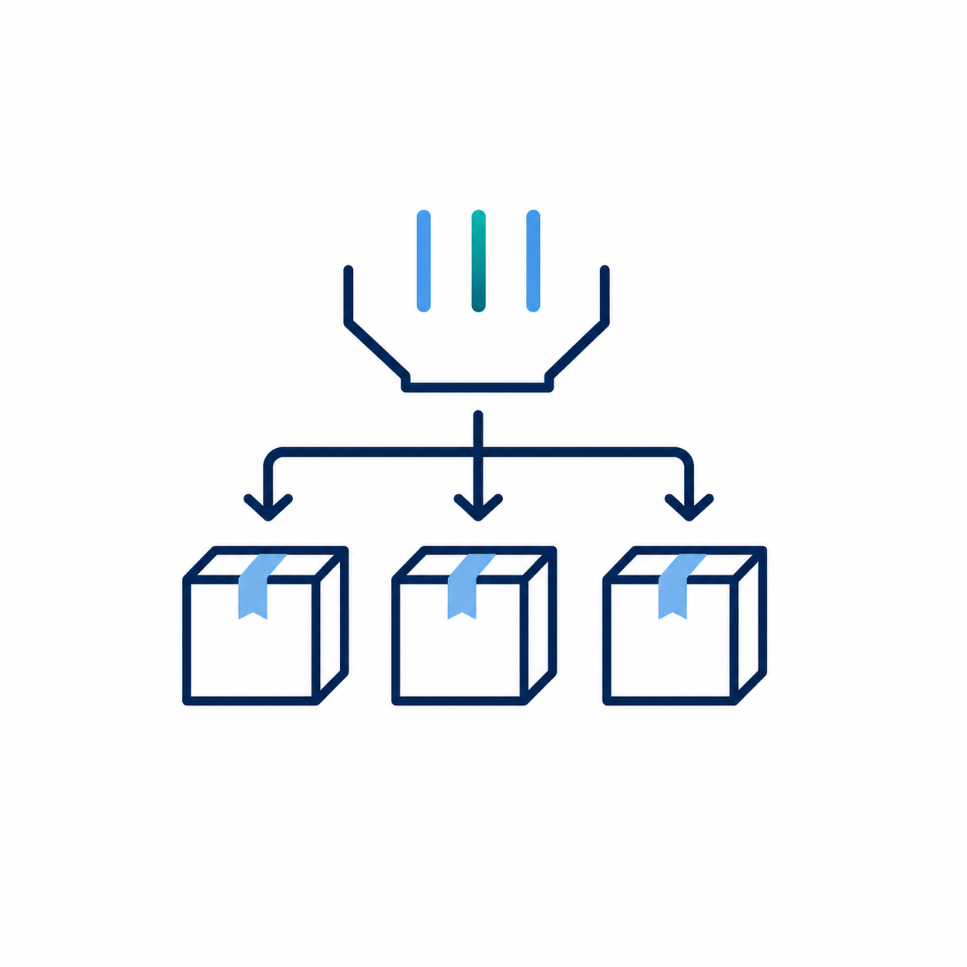
Non-nominal stress tests evaluated the operating limits of BO_014
Evaluation-only stress campaign
• Final configuration: BO_014
• 4 trained agents from the multiseed analysis
• 4 agents × 100 episodes per scenario
• Evaluation seed base: 2044876
• No retraining
• No reward, no PPO changes
Treadmill
velocity
Generation frequency
Parcel
shape
Total parcels per episode
Parcels per generation
The goal is to distinguish robust generalization from actual operating limitations.

Slide 11
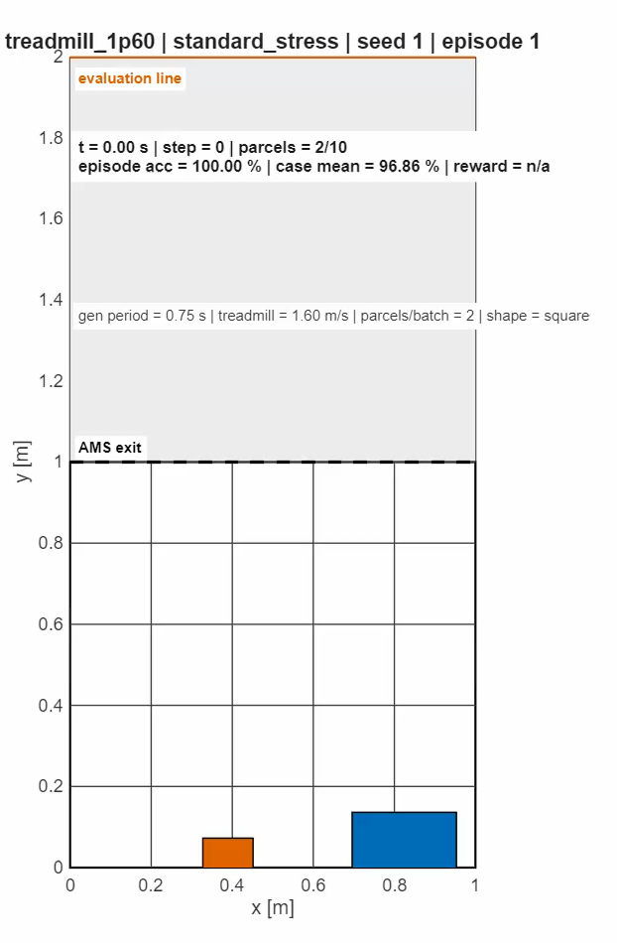
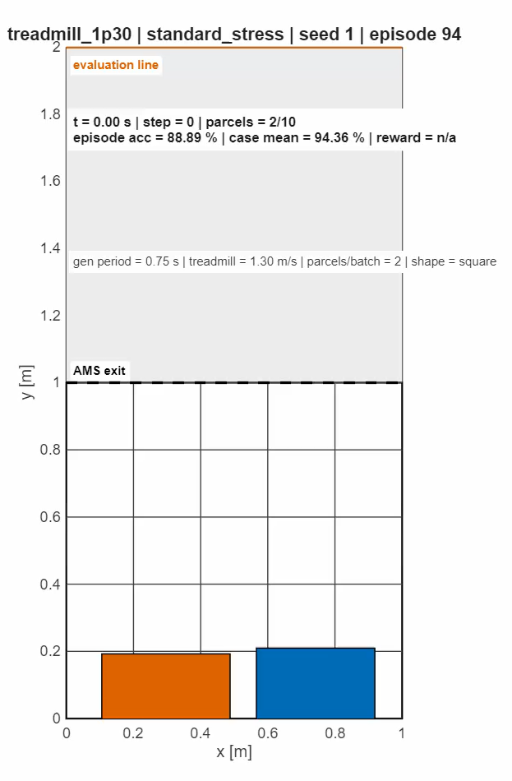
Reduced treadmill velocity caused moderate degradation
Treadmill velocity = 1,60 m/s
Treadmill velocity = 1,30 m/s
Nominal case
Mean Final Accuracy>5mm: 98,28%
Worst Agent Accuracy: 96,33%
Mean Max Overlap: 9,9 mm
Throughput: 8027 pph
Treadmill-1p60
Mean Final Accuracy>5mm: 96,86% -1,42 pp
Worst Agent Accuracy: 93,67% -2,66 pp
Mean Max Overlap: 14,1 mm +4,2 mm
Throughput: 7874 pph -153 pph
Treadmill-1p30
Mean Final Accuracy>5mm: 94,36% -3,92 pp
Worst Agent Accuracy: 88,00% -8,33 pp
Mean Max Overlap: 24,1 mm +14,2 mm
Throughput: 7662 pph -365 pph
Reduced downstream speed degrades separation quality, but it is not the most critical operating limitation.

Slide 12
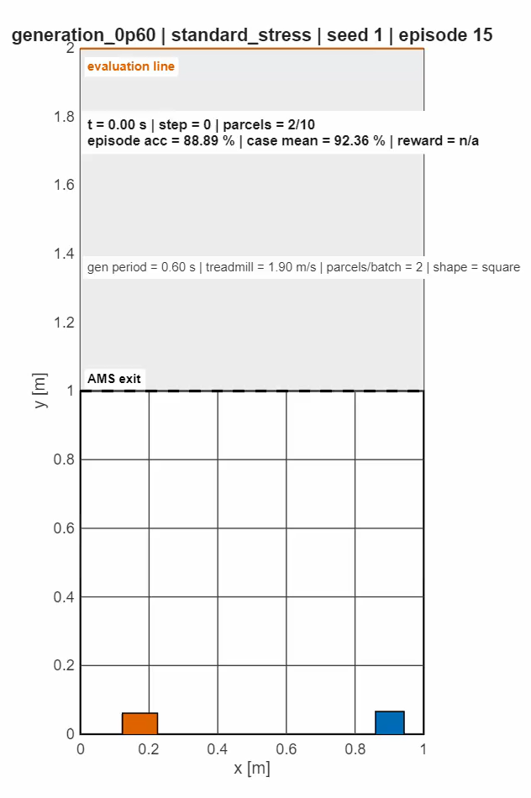
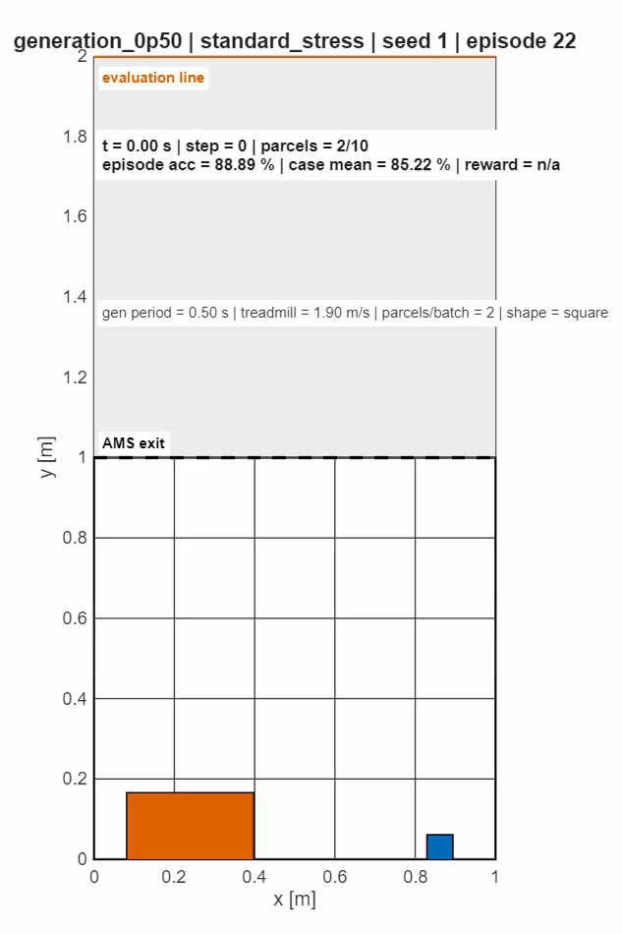
Higher generation frequency revealed a temporal inflow limit
Generation frequency = 0,60 s
Generation frequency = 0,50 s
Nominal case
Mean Final Accuracy>5mm: 98,28%
Worst Agent Accuracy: 96,33%
Mean Max Overlap: 9,9 mm
Throughput: 8027 pph
Generation-0p60
Mean Final Accuracy>5mm: 92,36% -5,92 pp
Worst Agent Accuracy: 90,89% -5,44 pp
Mean Max Overlap: 57,9 mm +48,0 mm
Throughput: 9243 pph +1216 pph
Generation-0p50
Mean Final Accuracy>5mm: 85,22% -13,06 pp
Worst Agent Accuracy: 77,67% -18,66 pp
Mean Max Overlap: 112,9 mm +103,0 mm
Throughput: 10360 pph +2333 pph
The policy degrades when parcels enter the AMS too frequently, leaving less time to recover longitudinal separation.

Slide 13
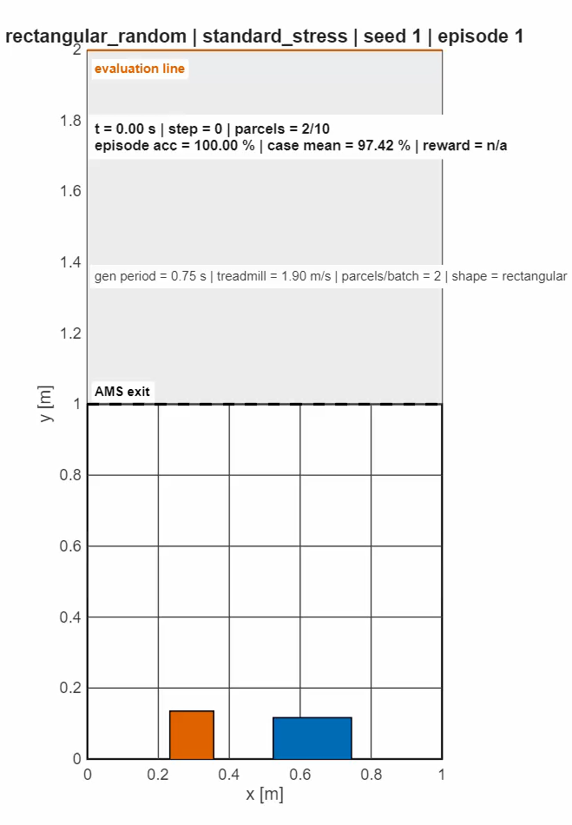
BO_014 generalized well to rectangular parcel shapes
Nominal case
Mean Final Accuracy>5mm: 98,28%
Worst Agent Accuracy: 96,33%
Mean Max Overlap: 9,9 mm
Throughput: 8027 pph
Rectangular parcels
Mean Final Accuracy>5mm: 97,42% -0,86 pp
Worst Agent Accuracy: 95,00% -1,33 pp
Mean Max Overlap: 17,9 mm +8,0 mm
Throughput: 8036 pph +9,0 pph
Rectangular dimensions randomly sampled within the nominal parcel-size bounds: [0.05, 0.40] m
The policy is not strongly tied to the nominal square-parcel assumption.

Slide 14
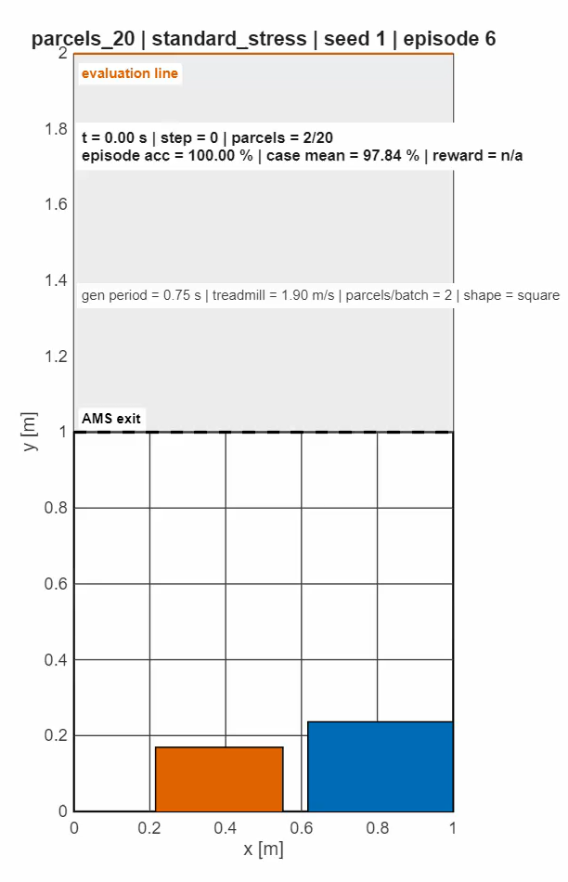
Increasing the total number of parcels did not collapse performance
Nominal case
Mean Final Accuracy>5mm: 98,28%
Worst Agent Accuracy: 96,33%
Mean Max Overlap: 9,9 mm
Throughput: 8027 pph
Parcels_20
Mean Final Accuracy>5mm: 97,84% -0,44 pp
Worst Agent Accuracy: 95,84% -0,49 pp
Mean Max Overlap: 25,1 mm +15,2 mm
Throughput: 8738 pph +711 pph
The policy scales well with the total number of parcels when the nominal pairwise generation structure is preserved.

Slide 15
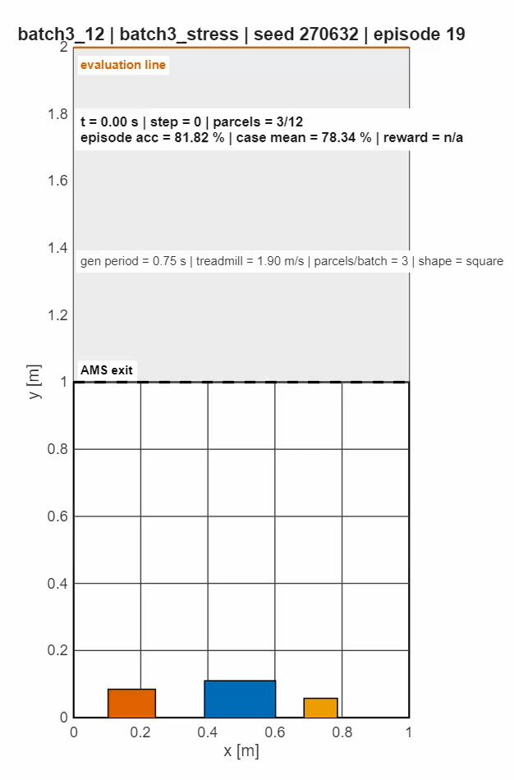
Three-parcel generation was the most severe stress condition
Nominal case
Mean Final Accuracy>5mm: 98,28%
Worst Agent Accuracy: 96,33%
Mean Max Overlap: 9,9 mm
Throughput: 8027 pph
Batch3_12
Mean Final Accuracy>5mm: 78,34% -19,94 pp
Worst Agent Accuracy: 72,00% -24,33 pp
Mean Max Overlap: 112,8 mm +102,9 mm
Throughput: 11481 pph +3454 pph
At each generation event, 3 parcels enter the system in a left-center-right configuration. To avoid artificial initial overlaps and preserve AMS-grid compatibility, the upper parcel-size bound was reduced to 0.30 m.
The number of parcels per episode was set to 12, corresponding to 4 complete batches.
The main difficulty is not only temporal inflow rate, but also simultaneous spatial crowding at generation.

Slide 16
Final outcome: strong nominal policy, clear robustness target
Validated formulation
Selected policy
Observed limitation
• Environment, reward, and physical KPIs were verified before final training.
• AverageReward was used only as a training diagnostic.
• BO improved PPO over the reference baseline.
• BO_014 achieved strong nominal and multiseed performance.
• Shape and parcel-count variations were handled well.
• Dense and simultaneous inflow remained the main robustness limit.
Next steps
Mixed high-density training · Crowding-aware observation · Congestion-aware reward terms · Curriculum learning
Future work should target robustness to dense inflow, where the current policy shows its clearest operating limit.

